Slide 1

Secured Health Repository
Vivekanand Education Society’s Institute Of Technology
Department Of Computer Engineering
Final Review
Project Mentor ; Mr. Prashant Kanade
Kaustubh Keny D12B 27
Yash Lakhani D12B 33
Vipin Talreja D12B 59
Group No. : 12

Slide 2
INDEX
Introduction
Problem Statement
Literature Survey
Technology Used
Methodology
Database Schema
Proposed GUI Design
Conclusion
Future Scope
References

Slide 3

INTRODUCTION
The COVID pandemic had affected the world in many adversarial ways throughout the past two years. One of them was the problem of patients being unable to diagnose and communicate with their doctors due to pandemic lockdown.
To bridge this communication gap between the patients and the doctors, we proposed a centralized health online repository system, which allows patients to upload, add their medical concern(s) and the doctors being able to diagnose them.
Since there are no COVID restrictions and the normal mode of diagnosis has been revived, our project stands as a proof of concept which still has potential for the future.

Slide 4
PROBLEM STATEMENT
Create web application for the following statements:
Prevention the duplication of tests or procedures and medical errors due to
easy access to pertinent health information.
Track down their previous medical records and ensure patient data is up-to-date.
Socially Distanced Medication Facilities during Pandemic.
Secure and user friendly interface for interaction between doctor and patients.

Slide 5
LITERATURE SURVEY
Vivekanand Education Society’s Institute Of Technology
Department Of Computer Engineering

Slide 6
SR NO | PAPER | AUTHOR/S | YEAR | SUMMARY | ADVANTAGES | LIMITATIONS
1. | Medical information registration and retrieval apparatus. | Barry J. Fiala & Diana L. Cowden | 2013 | The invention permits an individual to have his or her personal medical profile available to a physician, or health care provider. The user provides the information placed in the database.The information can then be retrieved by the use of a Personal Identification Number (“PIN”). | > The reports retrieved can be used in an emergency when the patient is not conscious. > The patient’s pharmaceutical purchases, prescriptions, and dosages can be updated into the database. | > In case the user forgot or misplaced their password, they cannot reset the password. > User needs to purchase the subscription/membership for storing reports .
SR NO | PAPER | AUTHOR/S | YEAR | SUMMARY | ADVANTAGES | LIMITATIONS
2. | Online Medical History Repository System and Medical Insurance Cover | Vipin Suthar & Sunny Nahar | 2015 | This paper suggests that National Insurance Authorities should provide a platform to the medical practitioners throughout the country so that they are able to access the centralized system as authorized personnel to create and feed information about person’s medical history as and when he/she is consulted with the physicians about his/her health problems. | > The centralized system will be helpful for insurance providers to thoroughly study of the medical history of the person. | > Dependent on medical practitioners to upload the medical reports. > No audits are mentioned for activity.

Slide 7
SR NO | PAPER | AUTHOR/S | YEAR | SUMMARY | ADVANTAGES | LIMITATIONS
3. | Networked medical data sharing on secure medium – A web publishing mode for DICOM viewer with three layer authentication | Sridevi Arumugham,Sundaram Rajagopalan, John Bosco & Rengarajan Amirtharajan | 2018 | This paper is based on image security solution.Uniqueness of the proposed scheme is that it brings together critical patient details, its encryption, watermarking on DICOM image and its authenticated access through three levels. The patient details including their diagnosis information, fingerprint and QR code of patient ID were shaped as an image and encrypted through multilayer confusion and diffusion operations. | > Details of patient history and their individual unique features such as thumb impression and QR code of patient ID are encrypted with chaotic maps & attractor and the results obtained from analyses convince a good level of confidentiality. > It is also suggested that the DICOM image can also be extended to cloud environment for better storage and convenient access of medical images | > Only one client can access the server at a time and the requesting clients can be allowed to use the server in a queuing manner
SR NO | PAPER | AUTHOR/S | YEAR | SUMMARY | ADVANTAGES | LIMITATIONS
4. | The Envirome Web Service: Patient context at the point of care | N.J. Kane , X. Wang , M.M. Gerkovich , M. Breitkreutz, B. Rivera , H. Kunchithapatham , M. A. Hoffman | 2021 | The EWS can help to promote health equity by enabling providers to easily recognize potential barriers to patient compliance with their recommendations and contextual factors that may contribute to their symptoms and health risks. Once aware of these barriers and risk factors, the conversation with a patient can explore possible alternatives or solutions through shared decision making. | > While there may be a known connection between a community-level indicator and patient health risk, the presentation and format of the indicator itself will affect its relevance and usability at the point of care. | > Without a clear path for mitigating the SDH through healthcare, screening can negatively impact patients and jeopardize the efficacy of a provider’s treatment plan.

Slide 8
SR NO | PAPER | AUTHOR/S | YEAR | SUMMARY | CONCLUSION
5. | The uneven impacts of avoiding public transit on riders’ access to healthcare during COVID-19 | Matthew Palm , Shelby L. Sturrock , Nicholas A. Howell , Steven Farber , Michael J. Widener | 2020 | In this cross-sectional survey of former transit riders, several groups were more likely to report deferring medical trips until they could use transit again. Former riders who were more likely to report that giving up transit made it difficult to access healthcare included those without a vehicle and those who found it hard to maintain physical distancing on their neighborhood streets. | >Transportation barriers to healthcare are known to impact marginalized, low income, and disabled individuals, as well as those with chronic illness. Although public transit can improve access to healthcare, many regular riders have avoided this mode of travel due to pandemic-related service disruptions and fears of COVID-19 exposure. >The data also measure self-reported changes to healthcare utilization and perceived difficulty in accessing healthcare and prescriptions, rather than objective records of health care use as is used in prior studies.

Slide 9
LACUNA IN THE EXISTING SYSTEM
The onset of COVID-19 pandemic sent turmoil into the normal way of life and disrupted many industries, especially medicine.
This unprecedented disruption led to the unavailability of a platform for communication between doctors and patients which was the biggest “lacuna” in the existing system.

Slide 10




HARDWARE , SOFTWARE REQS
Hardware:
Laptop/ PC
Software:
Front End : React.js
Back End : Node.js, Express
Database: mySQL

Slide 11
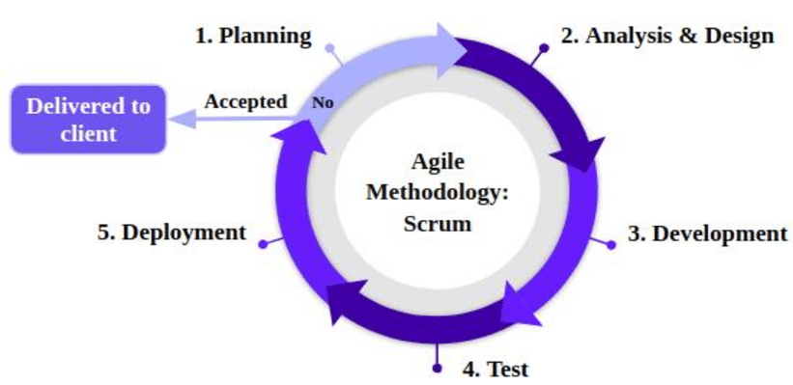
METHODOLOGY
Referring research papers based on the domain and topic.
Web Design
Database Design and mySQL implementation
Node Js for backend, React Js for frontend implementation

Slide 12
DATABASE SCHEMA DESIGN
Vivekanand Education Society’s Institute Of Technology
Department Of Computer Engineering

Slide 13
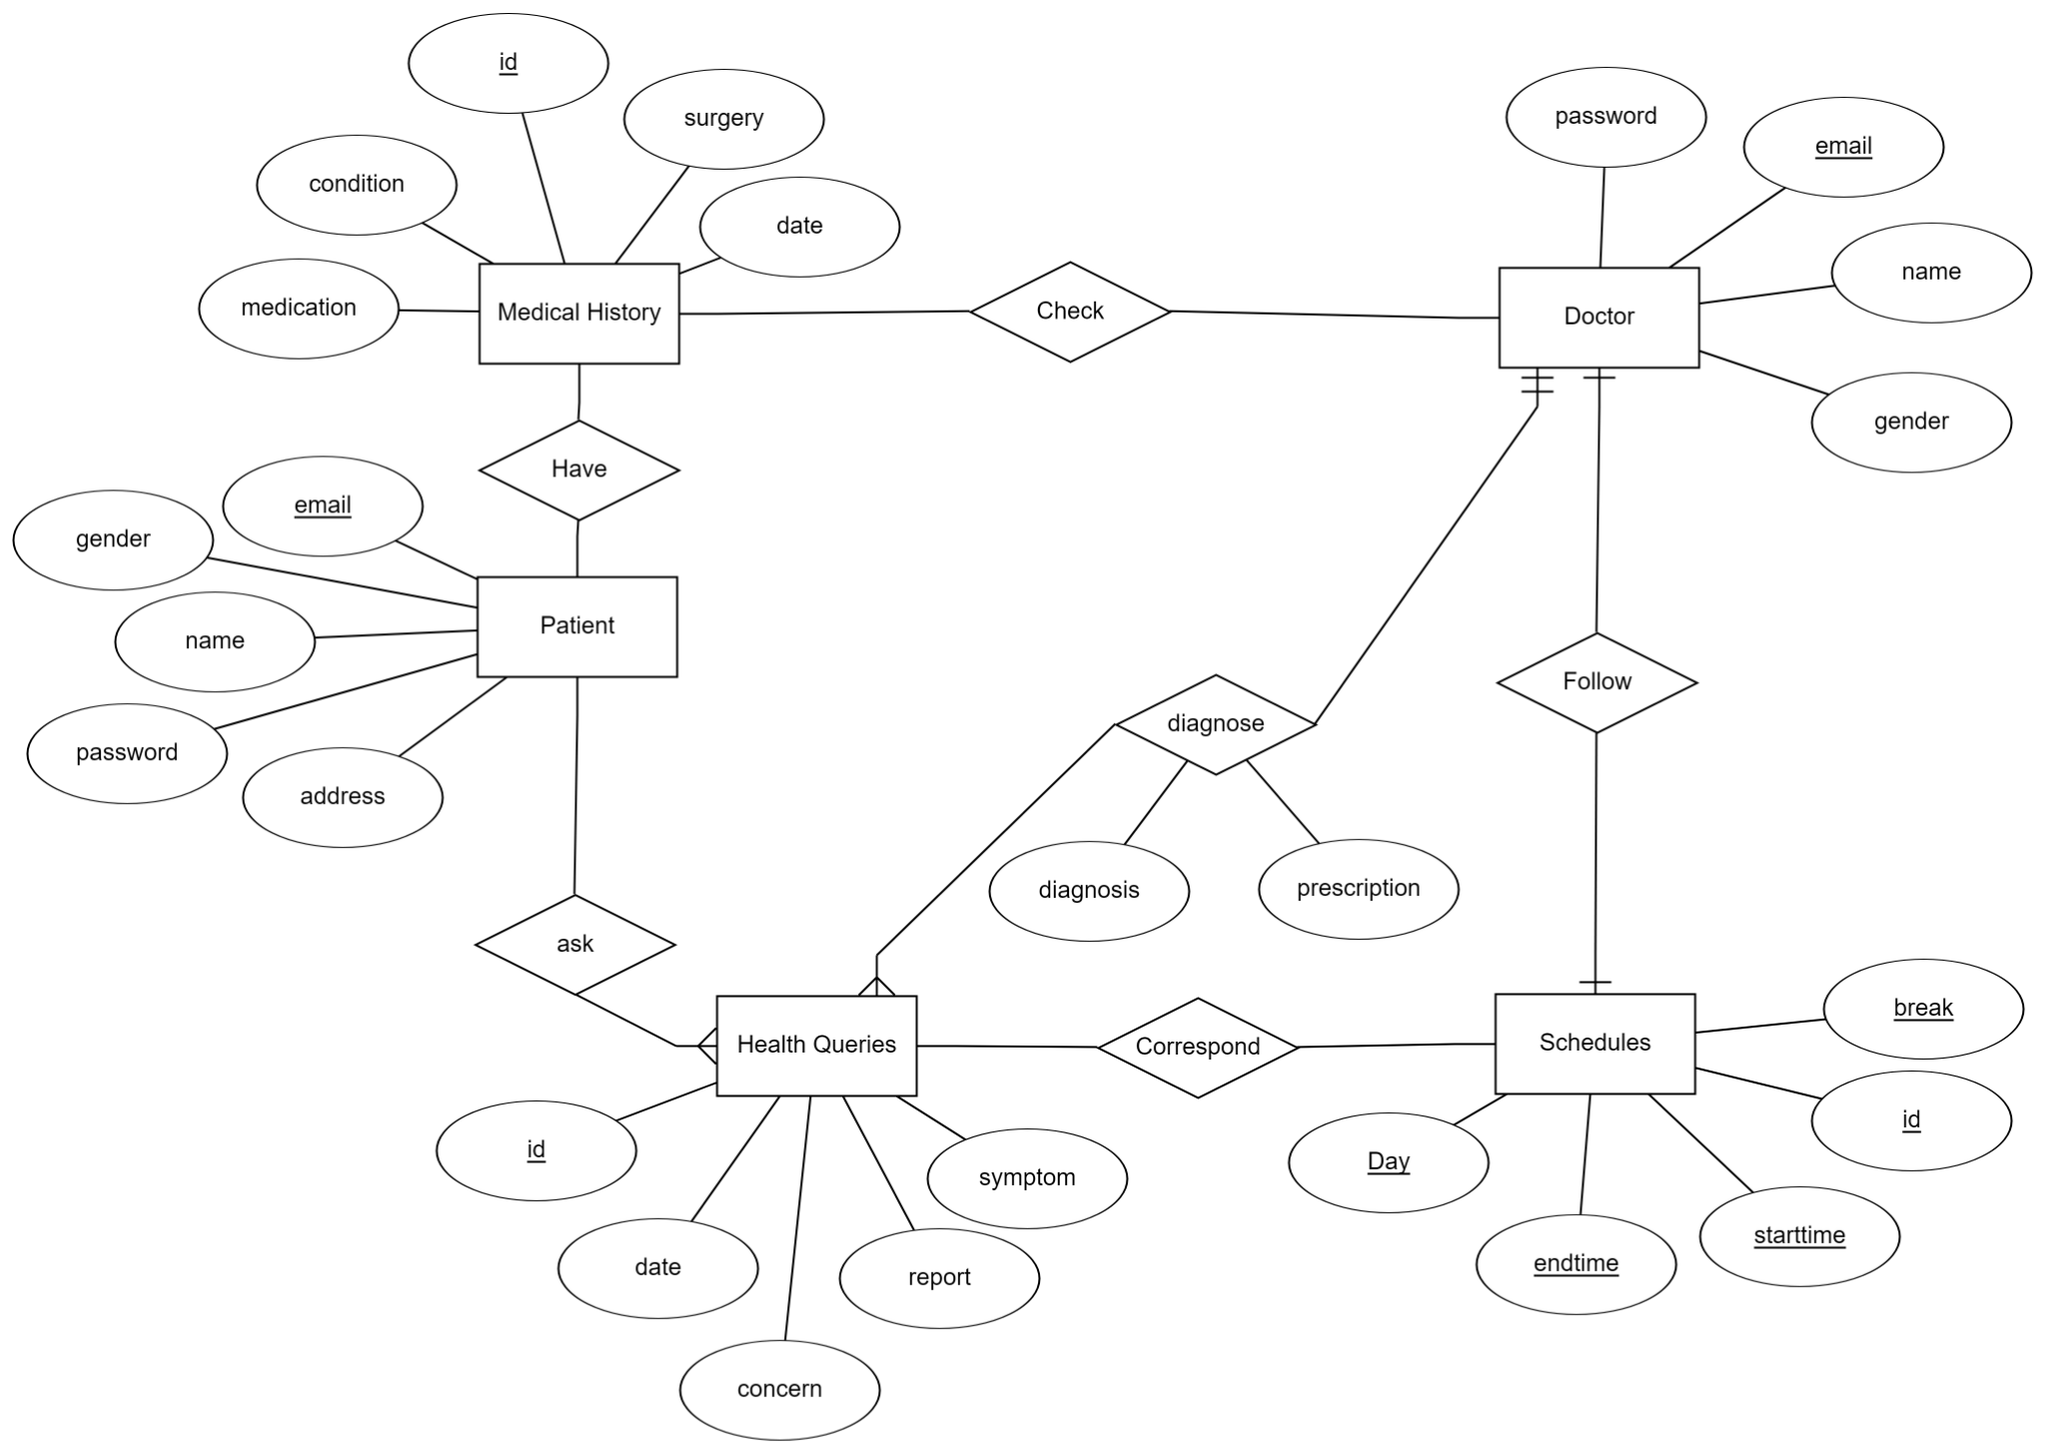

Slide 14
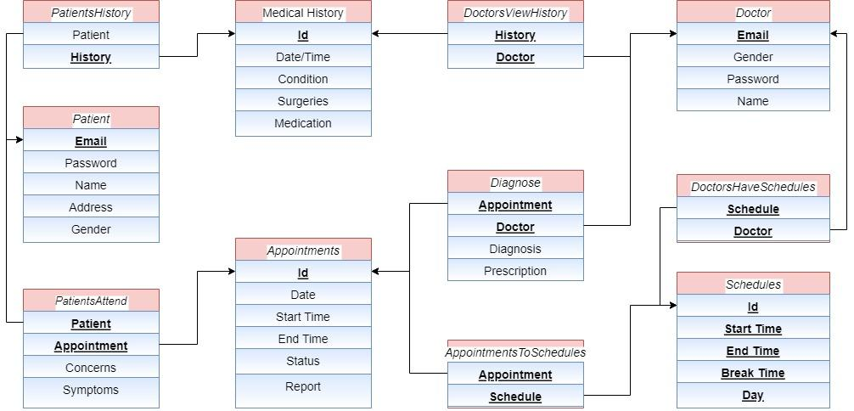

Slide 15
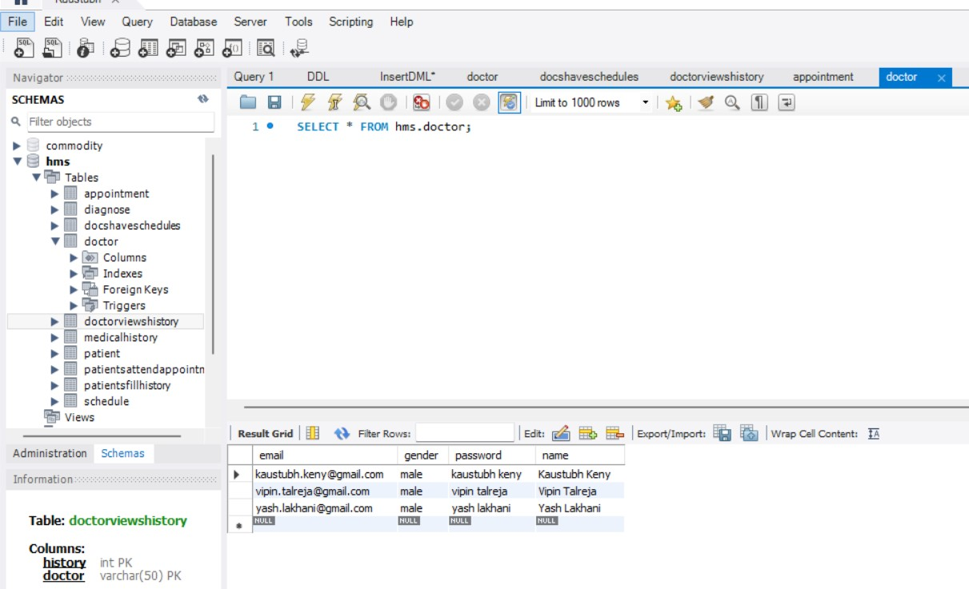

Slide 16
Patients
1. Patients have a separate login which leads to the interface made specifically for patients.
2. Patients can book health queries/appointments.
3. Patients can check previous medical history.
4. Patients can view/update/cancel already booked queries/appointments if necessary.
5. Cancelled reports create free slots for other patients in the doctor section.
6. The system avoids clash of report allocations with other patients. Each patient is therefore ensured his/her slot.
7. Patients are able to see complete diagnosis, prescriptions and medical history.
8. Patient medical history is only available to the doctor with whom the appointment is booked to ensure privacy.
Doctors
1. Doctors also have a separate login which leads to the interface made specifically for doctors.
2. The system takes into consideration doctor schedules and does not allow appointments when a doctor is already scheduled or has a break.
3. Doctors are able to access patient history and profile, and add to patient history.
4. Doctors are able to give diagnosis and prescriptions.
5. Doctors are able to modify diagnosis and prescriptions.

Slide 17
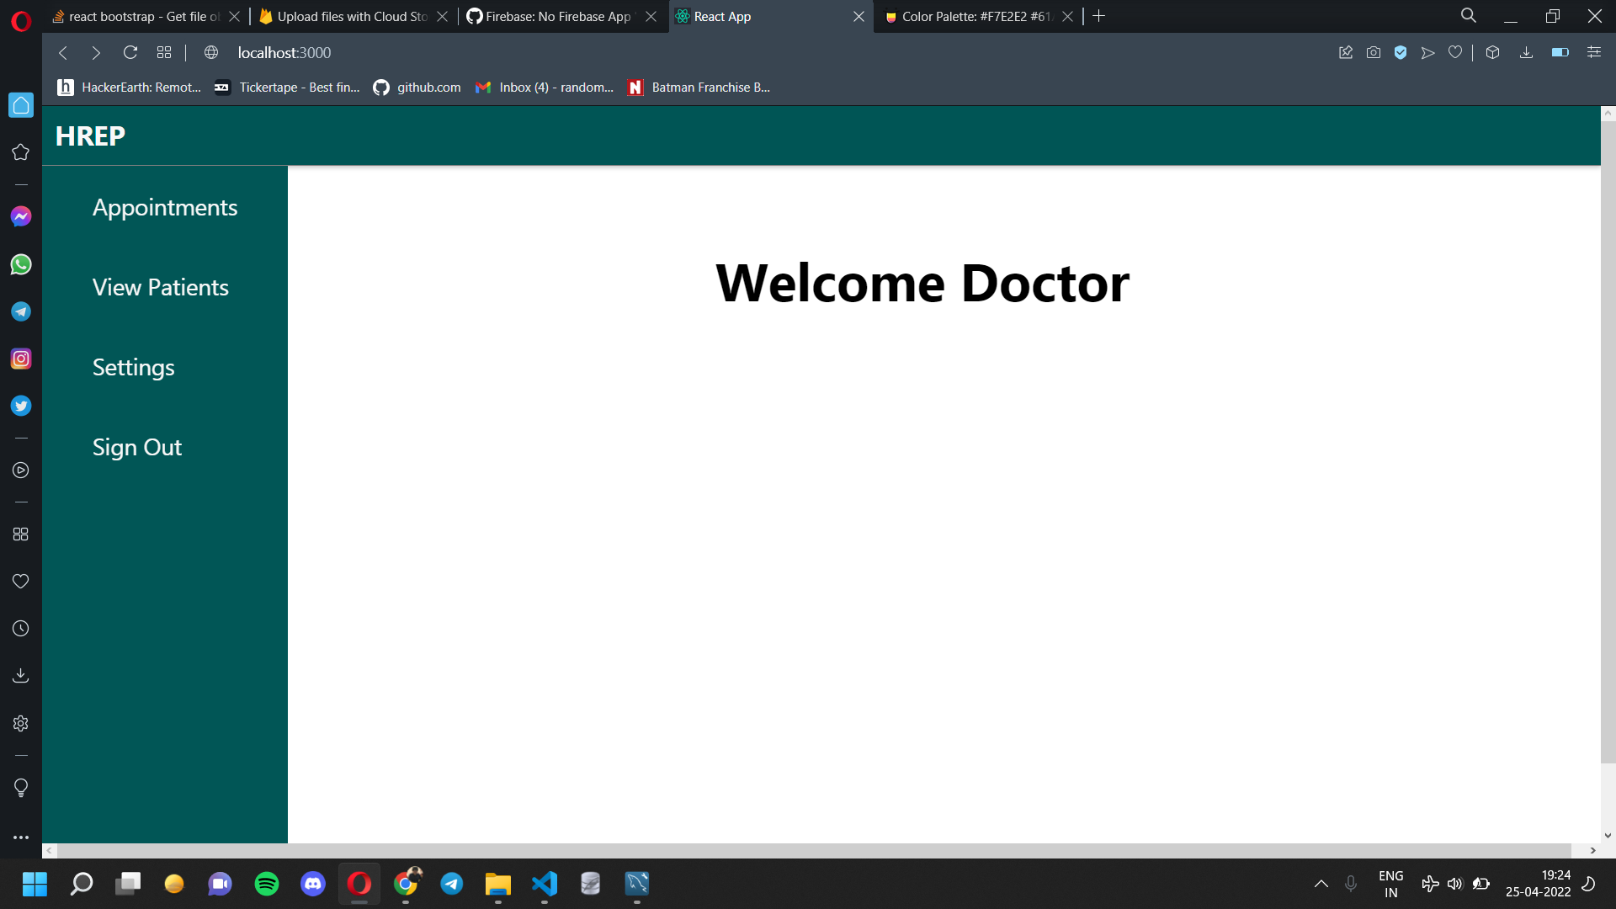
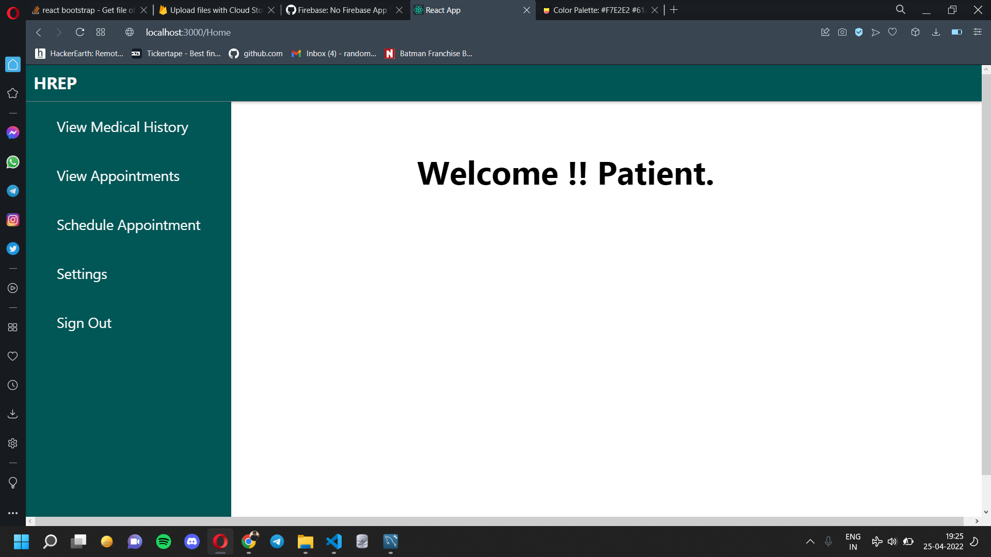
GUI DESIGN

Slide 18
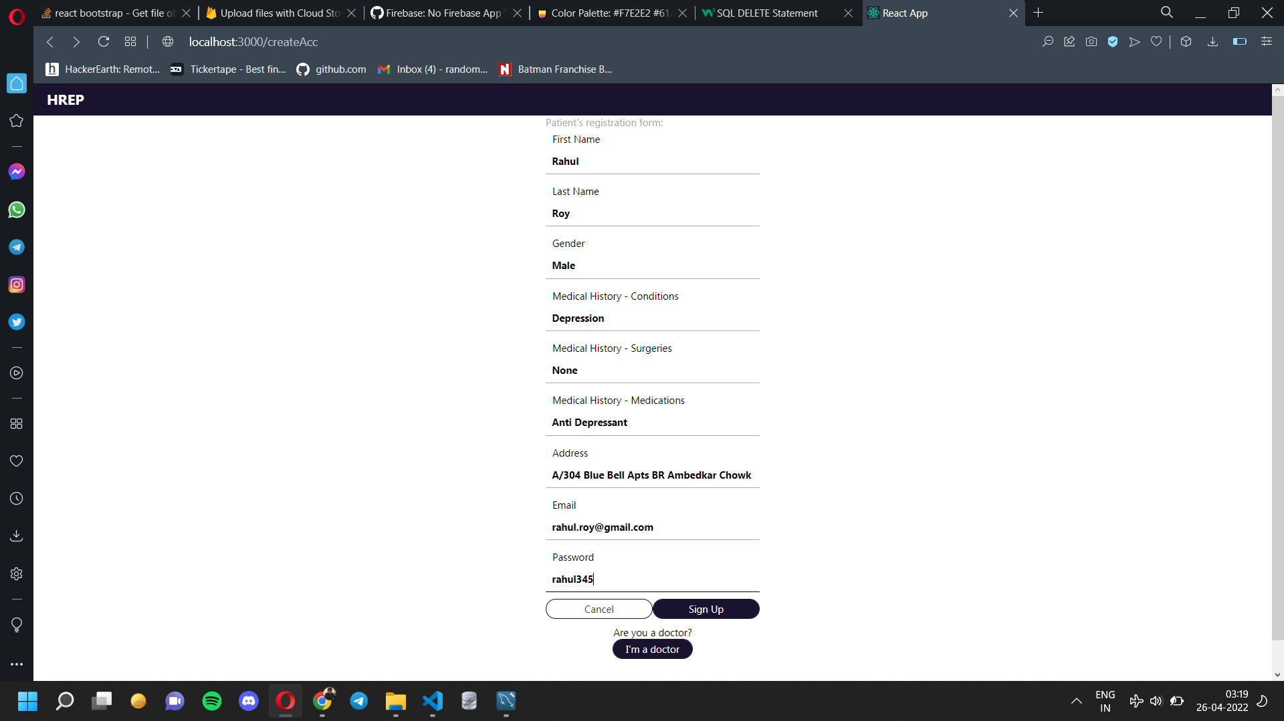

Slide 19
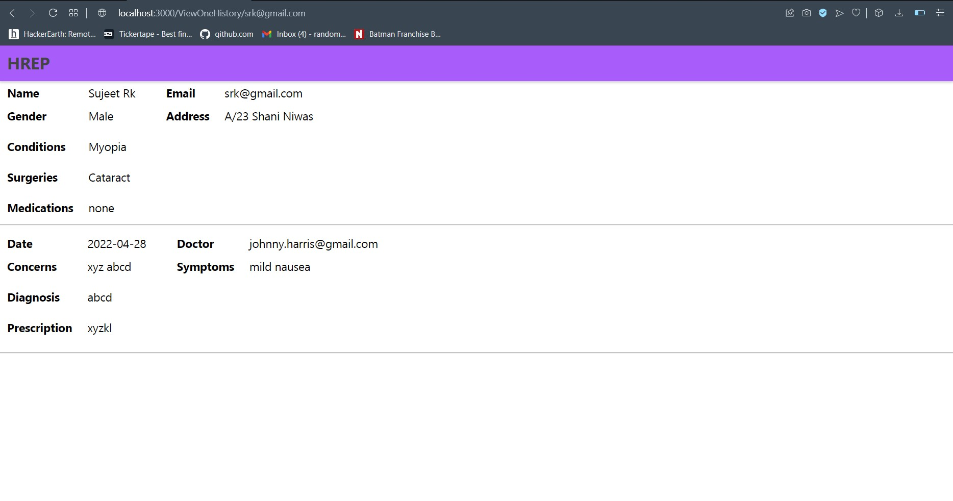

Slide 20
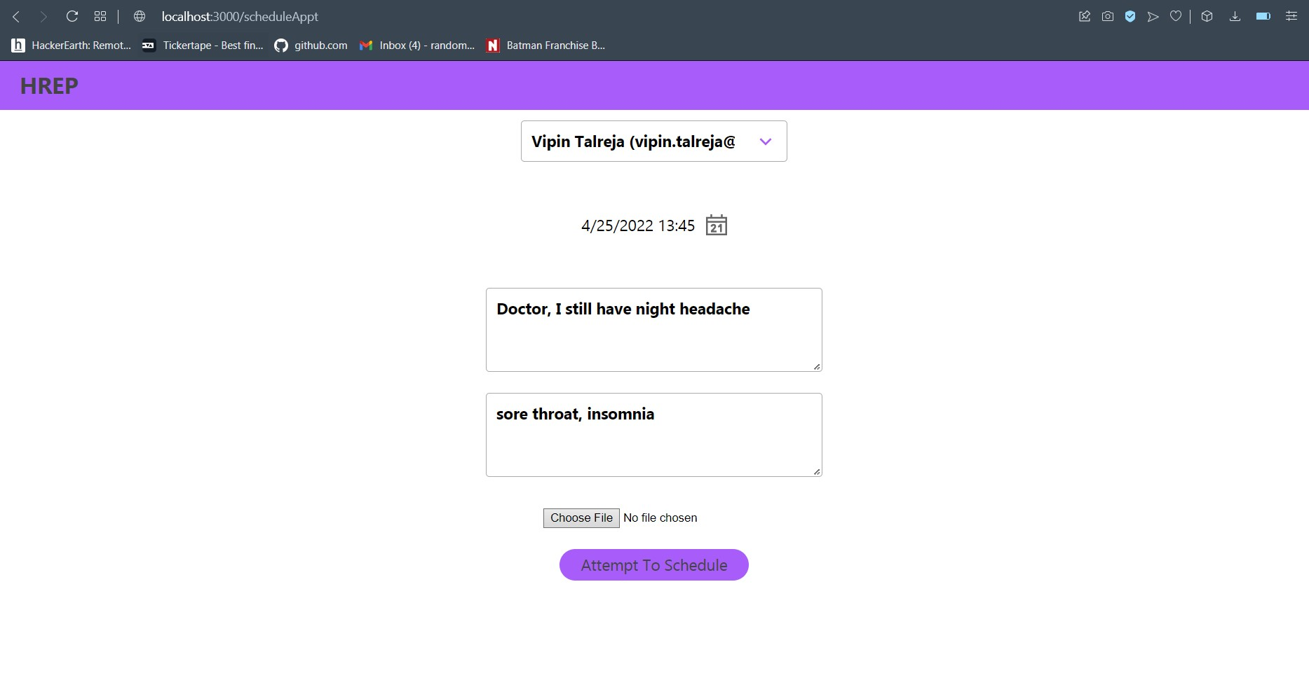

Slide 21
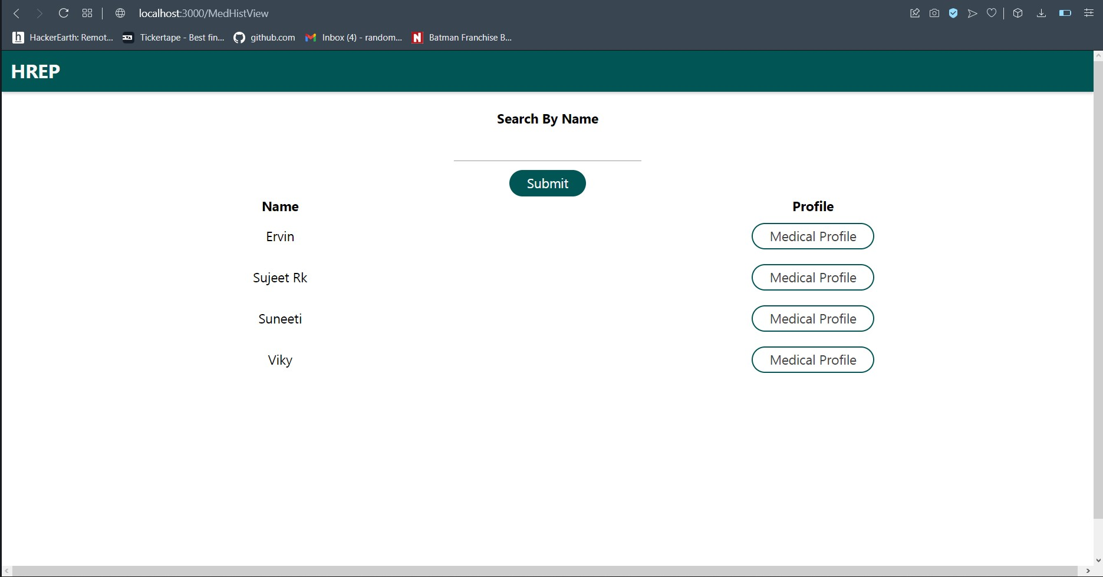

Slide 22
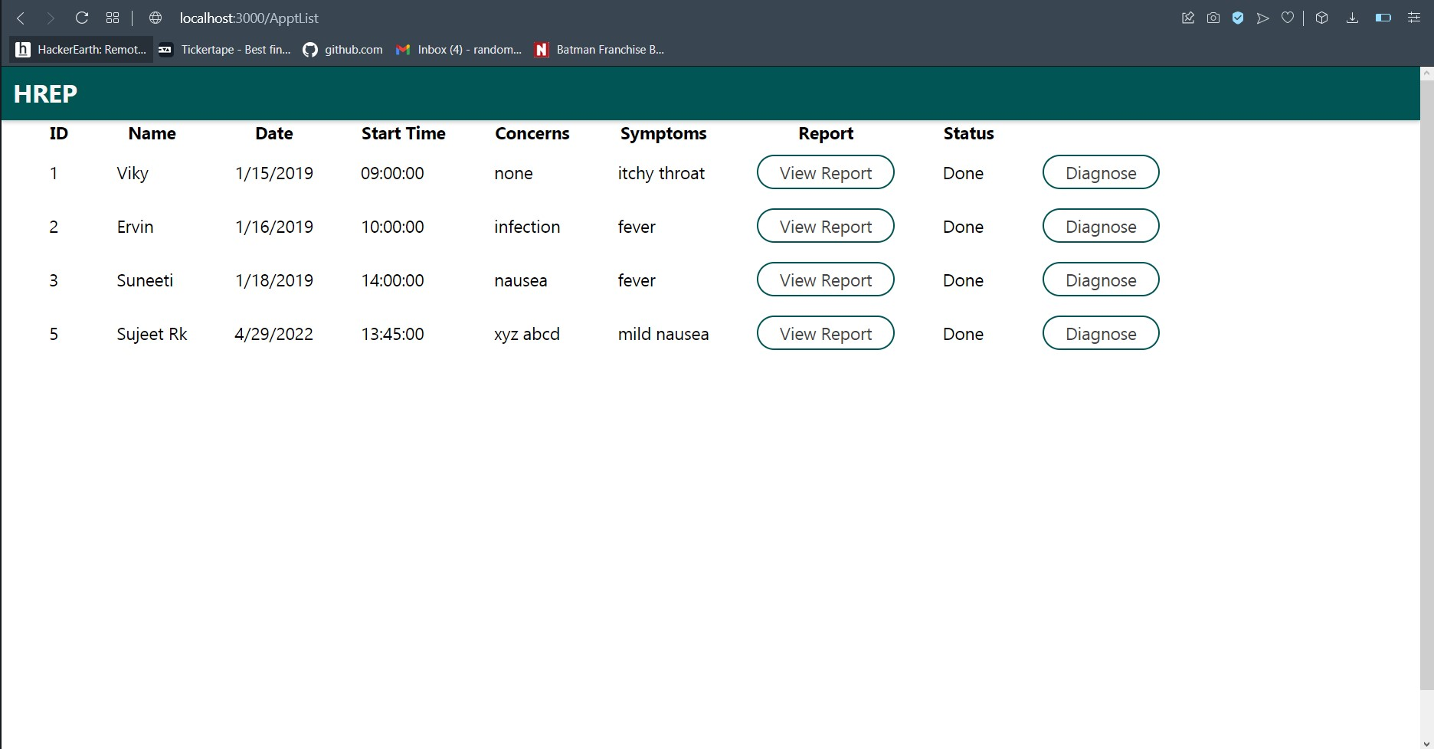

Slide 23

CONCLUSIONS
Database for HRR implemented, backend implemented, frontend implemented.
The aim of the project to bridge the gap between doctor and patients has been achieved via the project and remains as a proof of concept.
The project would definitely make it more convenient for both the patients and the doctors.

Slide 24
FUTURE SCOPE
The core of the project has been implemented, which consists of database implementation, website design and implementation.
Live in Video Session for Doctor Patient Diagnosis (start time/end time).
Implement Sentiment Analysis on the doctor’s diagnosis of patient reports.
Feature to upload reports in PDF format based on the patients various health records

Slide 25
REFERENCES
[1] Barry J. Fiala & Diana L. Cowden.-- “Medical information registration and retrieval apparatus and method regular” ,Russell H. Walker Walker, McKenzie & Walker, P.C. Suite 434 6363 Poplar Avenue Memphis, TN38119-4896 (US)
[2] Vipin Suthar & Sunny Nahar-- “ Online Medical History Repository System and Medical Insurance Cover” ,V.E.S Institute of Technology, Approved by AICTE & Affiliated to Mumbai University, Hashu Advani Memorial Complex, Collector colony, Chembur-400074
[3] Sridevi Arumugham,Sundaram Rajagopalan, John Bosco & Rengarajan Amirtharajan,-- “Chaos based crossover and mutation for securing DICOM image”, Comput. Biol. Med. 72 (2016) 170–184,
[4] N.J. Kane , X. Wang , M.M. Gerkovich , M. Breitkreutz, B. Rivera , H. Kunchithapatham , M. A. Hoffman-- “The Environment Web Service: Patient context at the point of care ”
[5] Matthew Palm , Shelby L. Sturrock , Nicholas A. Howell , Steven Farber , Michael J. Widener- “The uneven impacts of avoiding public transit on riders’ access to healthcare during COVID-19”

Slide 26
THANK YOU
Vivekanand Education Society’s Institute Of Technology
Department Of Computer Engineering

